Slide 1

G I T
TO GET
“TOGETHER”

Slide 2

Outline

Slide 3
About 'GIT'

Slide 4

GIT to GIT HUB
Web Based GIT
Online Collaboration
Made by Linus atom Preston -in 2008

Slide 5
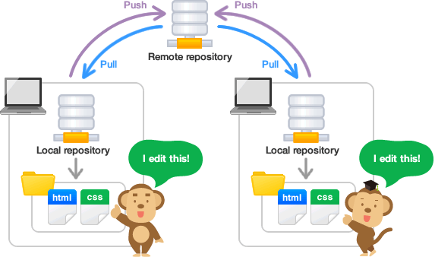

Things To Think
Git Repository(Repo)
  Remote Repository
  Local Repository

Slide 6
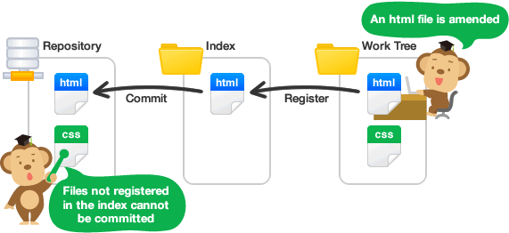
GIT Areas

Slide 7
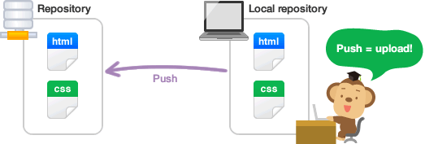
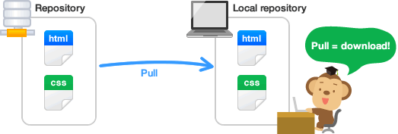
GIT Operations
Clone
Pull(Fetch + Merge)
Push
Commit
Checkout

Slide 8
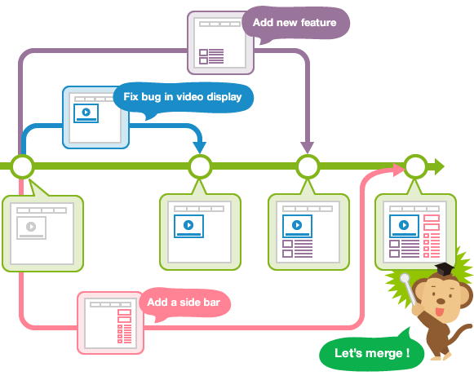
Branching & Merging
  Independent line of Development
  MasterBranch or Integration Branch
  Topic Branch

Slide 9
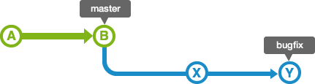
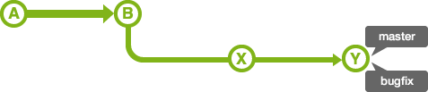
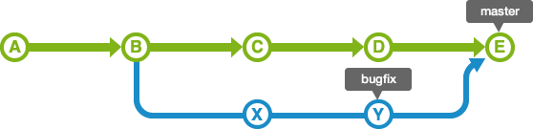
Branching & Merging

Slide 10
Outline

